Slide 1
Transformer-Enhanced EfficientNet Architecture for Multi-Class Brain Tumor Classification
Asrar Almogbil
King Fahd University of Petroleum and Minerals
Supervised by: Dr. Muzammil Behzad

Slide 2
Outline :
Introduction
Literature Review
Limitations
Vanilla model and challenges
Enhanced model
Dataset and preprocessing
Performance metrics
Experimental setup
Experiments and results

Slide 3
Introduction
On the report of the WHO, cancer is considered one of the main causes of death. One of the most common and aggressive types is brain tumors.
Early recognition of brain tumors is important for management planning.
As the manual detection and classification of brain tumors can be time-consuming and error-prone, the process needs to be automated.

Slide 4
Literature Review
Machine learning
Feature extraction methods such as Wavelet Transform (GWT), Local Binary Pattern (LBP)
Classifiers such as KNN,SVM
Deep learning
Learn data such as CNN and LSTM.
Transfer models
Pretrained models

Slide 5
Limitations
Currnt approaches focuses on local feature extraction and does not capture the global relationships.
There is a need to have transformer-based architectures to extract richer features.

Slide 6
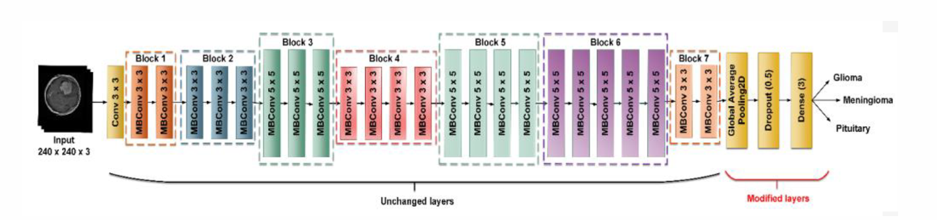
Vanilla model
Vanilla model EfficientNetB2 architecture [1]

Slide 7
Challenges
Limited ability to capture global relationships
Confusion between visually similar classes
No positional awareness

Slide 8
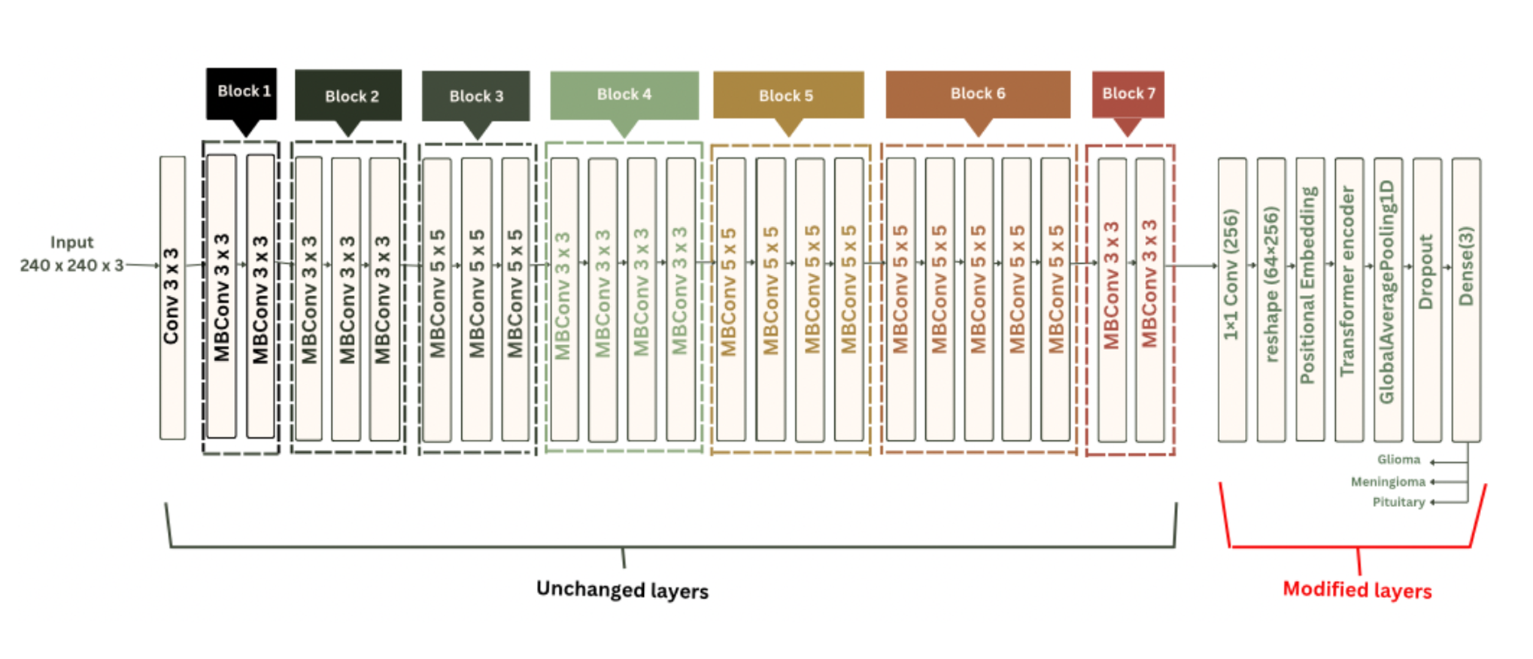
Proposed Enhancement
proposed model EfficientNetB2 architecture

Slide 9
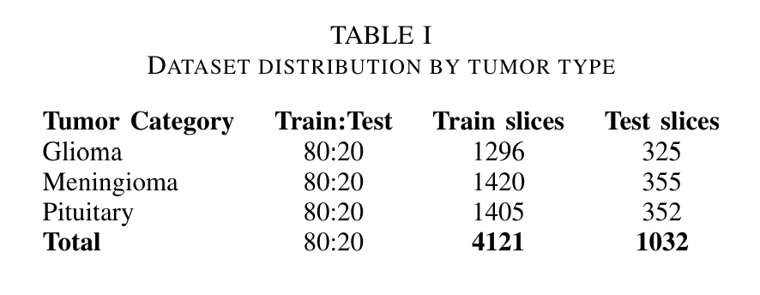
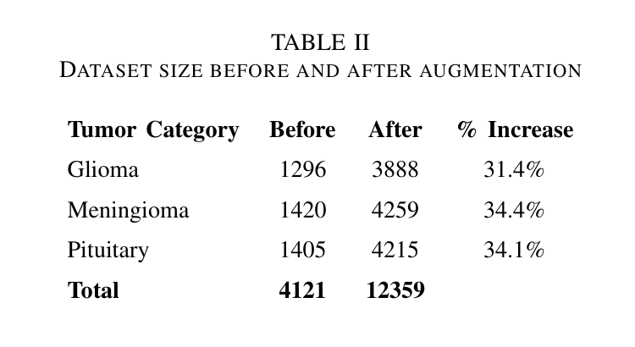
Dataset and preprocessing
resized into 240*240*3 to match the input shape that is required by the pretrained EfficientNetB2 model
cropped by extracting the extreme points
Grayscale → Gaussian blur filter → thresholding , erosion, and dilation
shuffling is applied to enhance training

Slide 10
Performance metrics
Accuracy: is the percentage of the instances that are classified correctly.
Precision: percentage of true positive predictions. False positives must be avoided.
Recall : is the percentage of true positive cases that the model predicts correctly. false negatives are dangerous.
F1score : combine both Precision and recall.
Confusion matrix : a layout that displays the number of correct and mistaken predictions by contrasting the actual and predicted labels. This layout provides an evaluation of the general model performance and the model performance for each class.

Slide 11
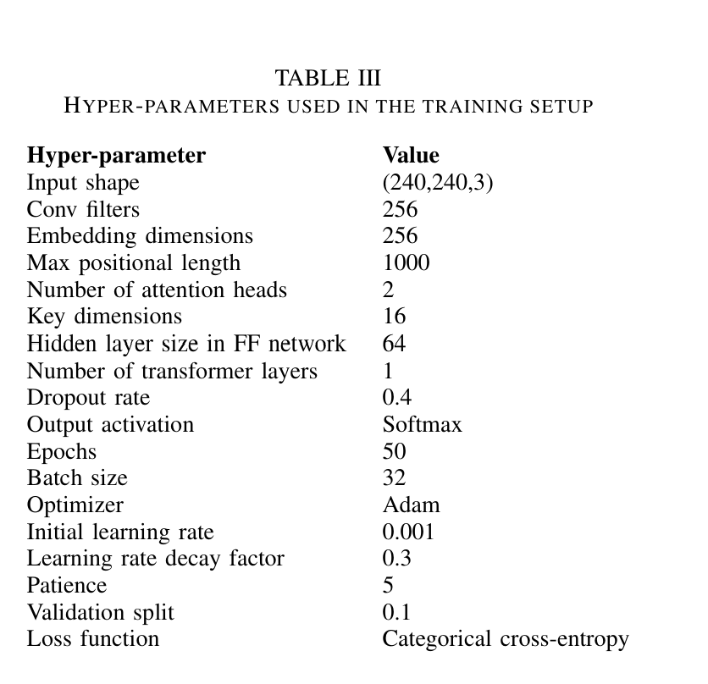
Experimental setup

Slide 12
Experments and Results
Model | Accuracy | Macro F1 | Effect
Vanilla model | 0.9874 | 0.9873 | Base model
Vanilla + Label smoothing | 0.9874 | 0.9875 | Neutral effect
Proposed model | 0.9874 | 0.9885 | BEST performance
Proposed + Label smoothing | 0.9855 | 0.9854 | Reduction in accuracy
Proposed + CBAM attention | 0.9864 | 0.9865 | Reduction in accuracy |

Slide 13
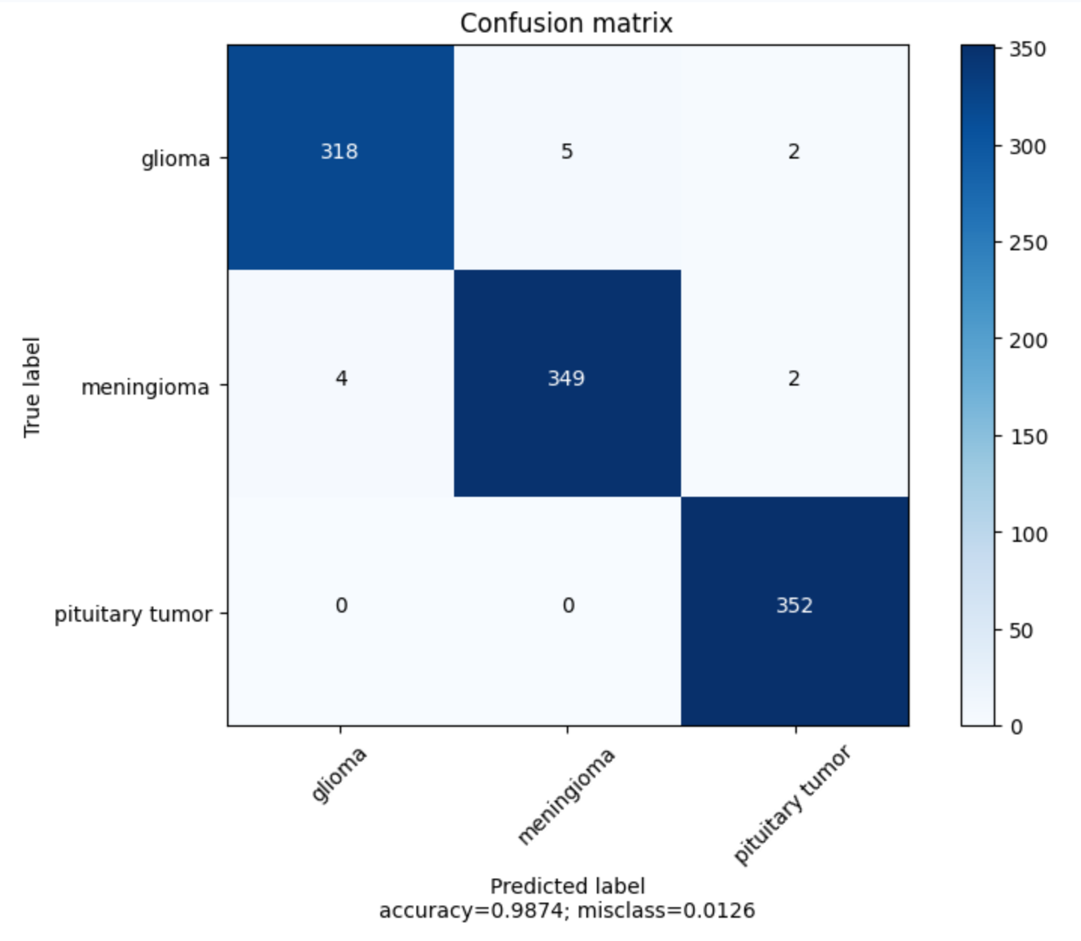
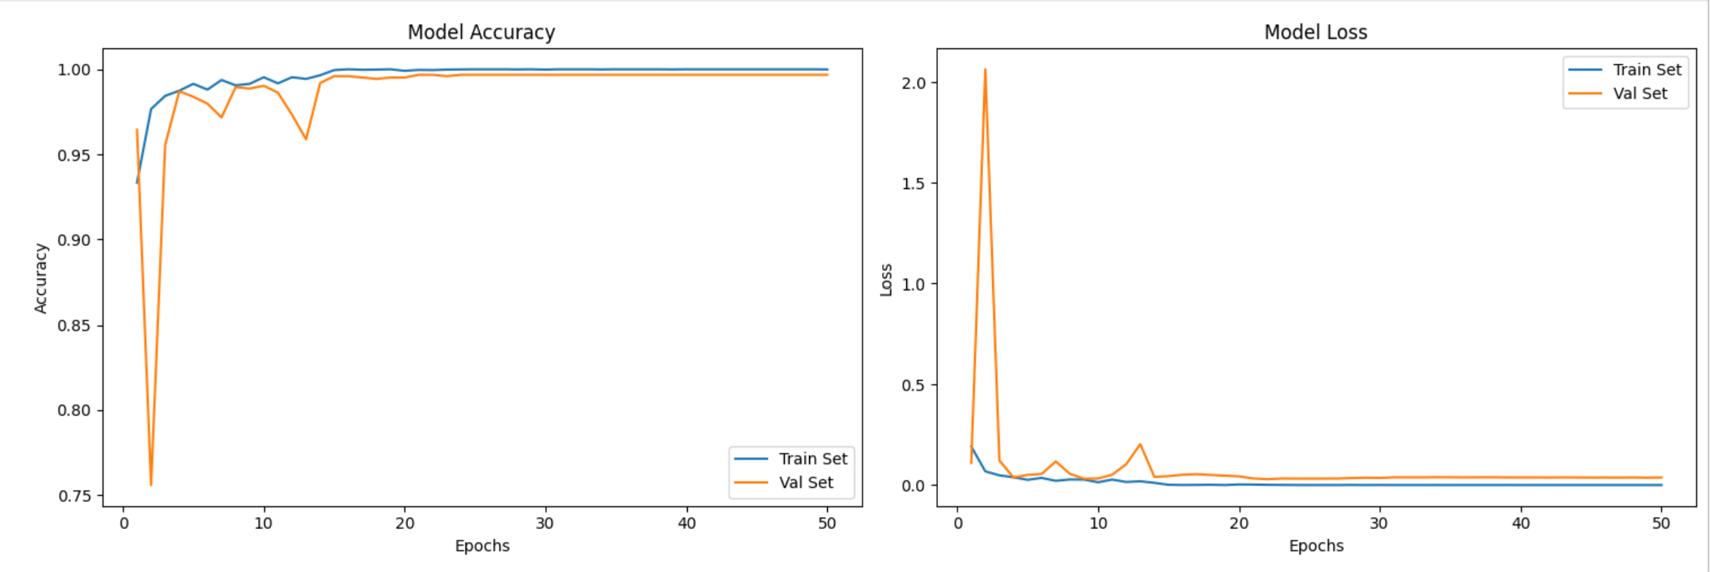
Results (Vanilla model)

Slide 14
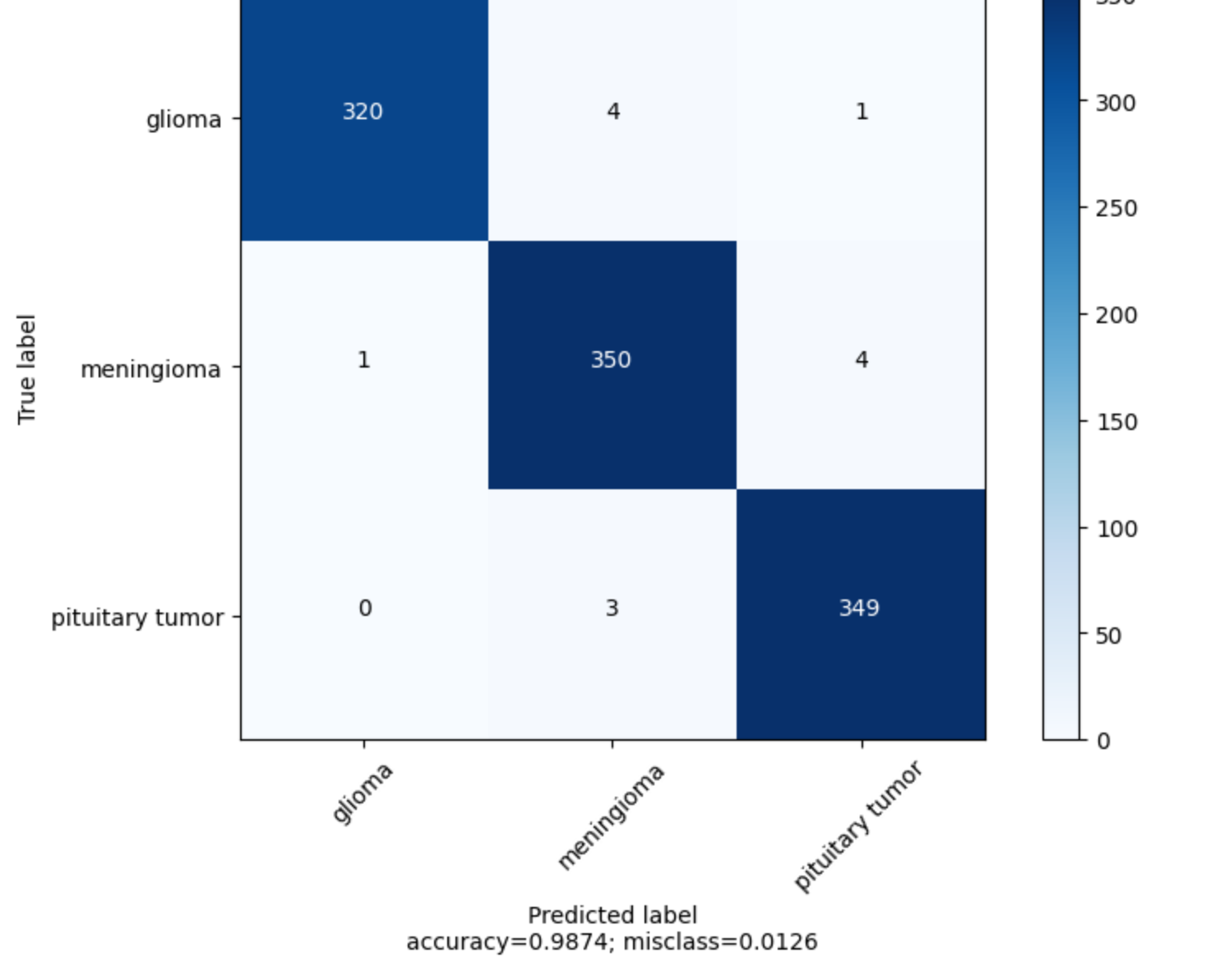
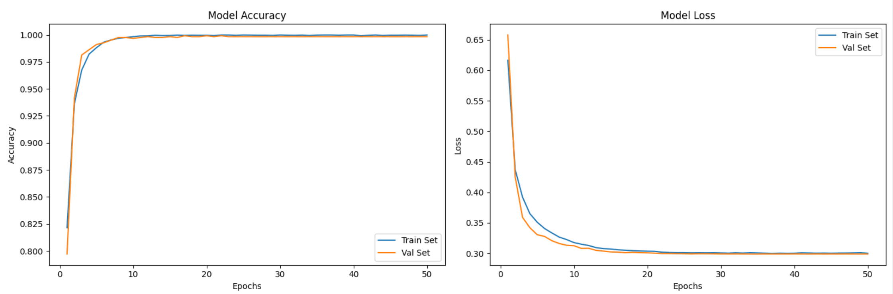
Results (vanilla model with label smoothing)

Slide 15
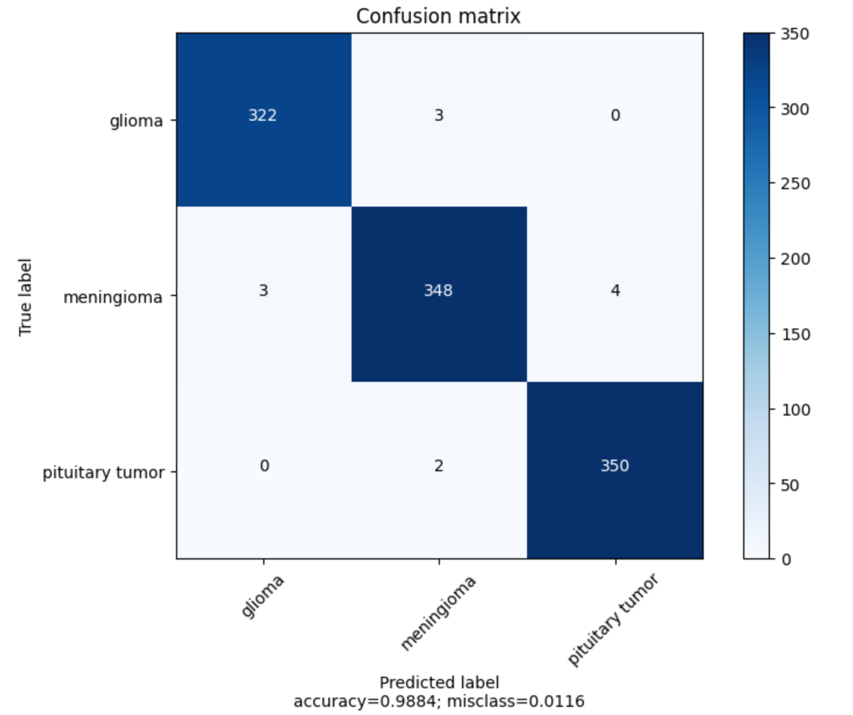
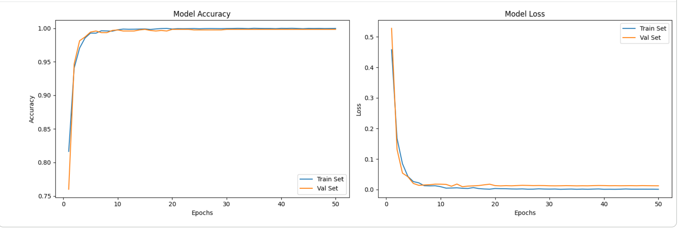
Results (enhanced model)

Slide 16
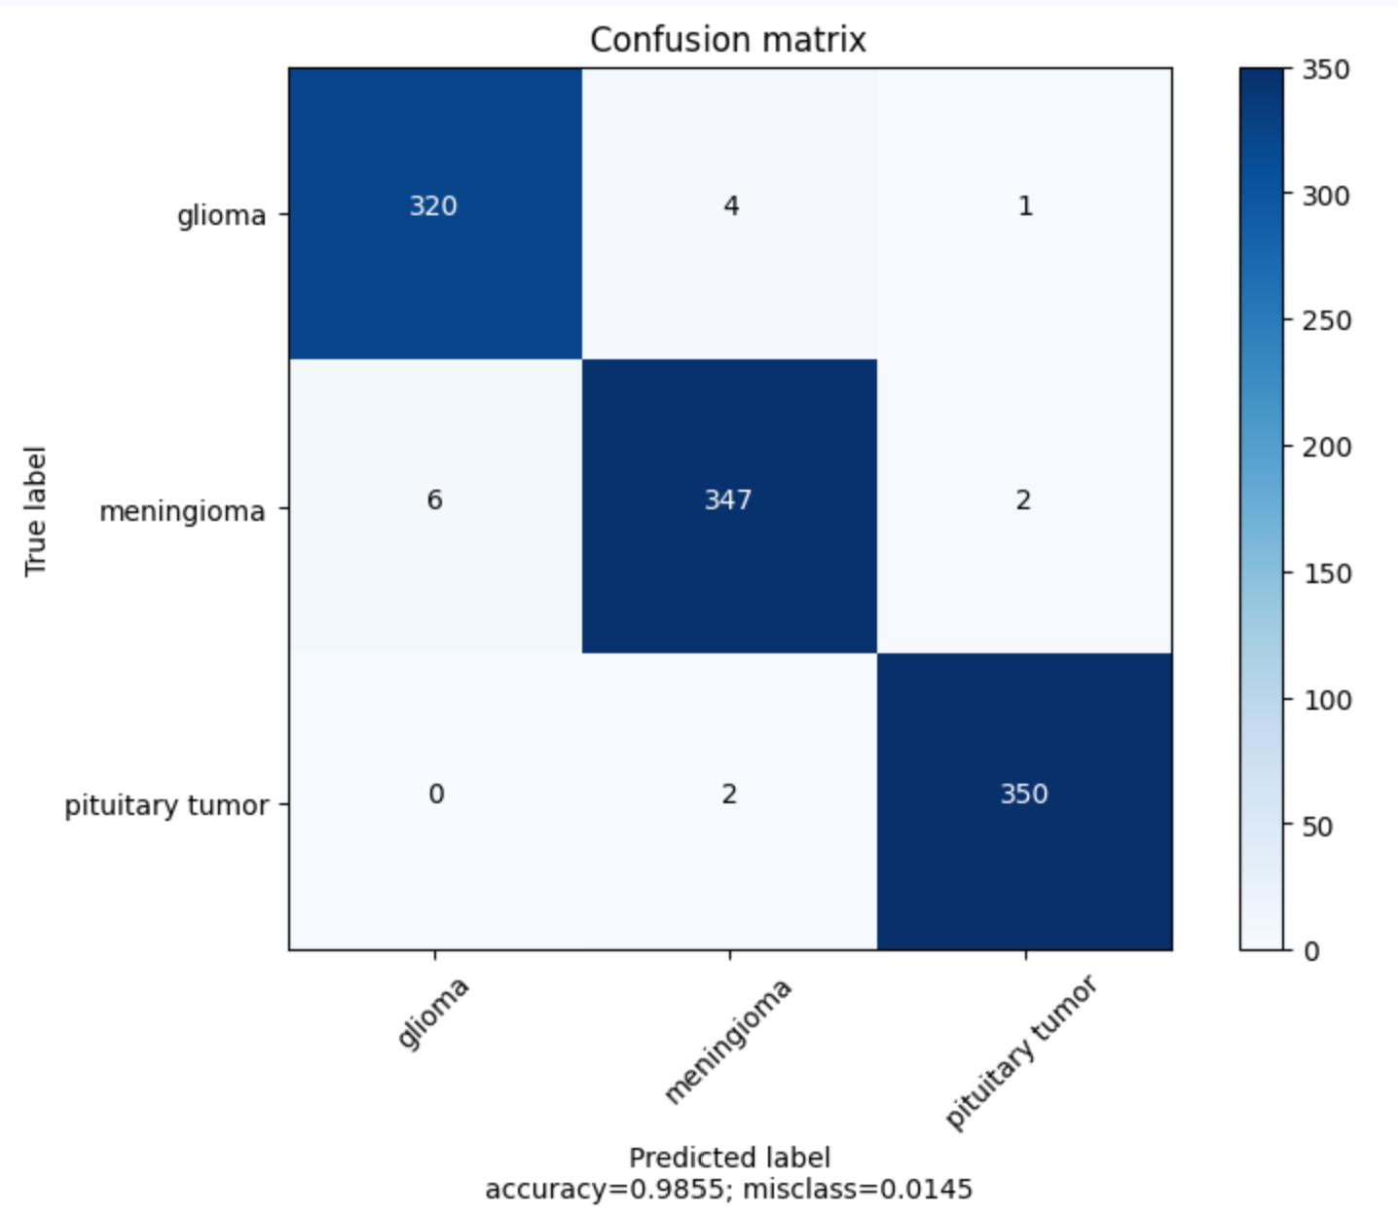
Results (enhanced model with label smoothing )

Slide 17
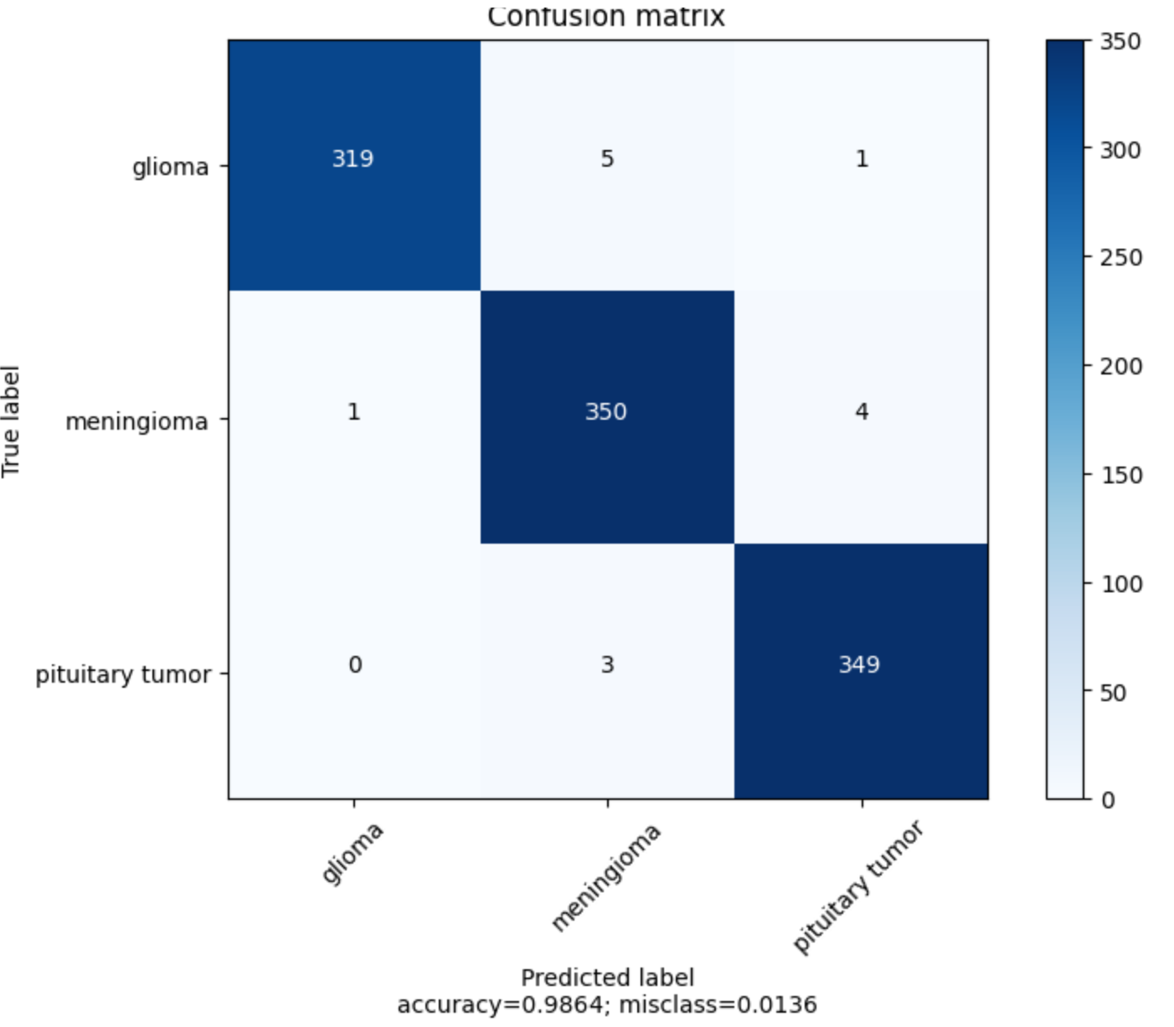
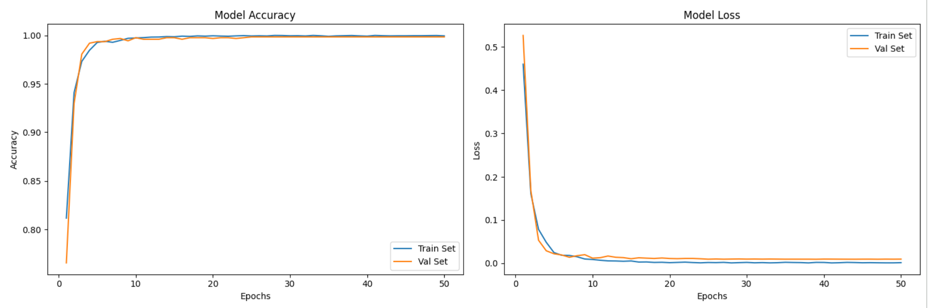
Results (enhanced model with CBAM layer)

Slide 18
Conclusion and future work
Hybrid EfficientNet + Transformer architecture improves accuracy
Better at modeling spatial relationships
Stronger glioma classification
Further directions can be explored:
  combining the transformer with other models with different numbers of transformer layers to enhance feature capturing .
  evaluate the system on a larger, more diverse dataset to assess the robustness and generalization.

Slide 19
Refrences
[1] F. Zulfiqar, U. I. Bajwa, and Y. Mehmood, ”Multi-class classification of brain tumor types from MR images using EfficientNets,” Biomedical Signal Processing and Control, vol. 84, p. 104777, 2023.

